Slide 1

Inventory Management System
CSI1007 – Software Engineering Principles Laboratory
23MIC0079 - Akshat Agrawal
23MIC0058 – Megha Gautam
23MIC0059 – Jayesh Pani
23MID0443 – Ishita Solanki

Slide 2
Inventory Management System
Description of the Project: An Inventory Management System is a software application designed to efficiently track and manage inventory levels, stock, orders, sales, and deliveries. This system enables businesses to automate inventory-related processes, reducing manual errors and optimizing stock management. Key features include real-time inventory tracking, stock alerts, order processing, and detailed reporting. It is particularly useful for streamlining operations in retail, warehouses, and supply chain management, ensuring products are available when needed while minimizing overstock or stockouts. The system can be implemented using technologies like SQL for database management and frameworks like Django, Flask, or MERN for user interface and functionality.
Scope of the Project: To develop a secure and user-friendly Inventory Management System (IMS) that automates inventory tracking, streamlines order management, and integrates with external systems to improve operational efficiency.

Slide 3
• Impact of the developing Project:
Economic Impact:
1) Reduces operational costs and minimizes waste through automated inventory tracking.
2) Increases productivity and profitability by improving order management.
3) Enhances competitiveness by providing better service and accuracy.
Social Impact:
1) Creates job opportunities in development, support, and training.
2) Improves customer satisfaction with better stock availability and faster delivery.
3) Increases employee focus on strategic roles, improving workplace satisfaction and safety.
Technological Impact:
1) Promotes innovation through modern technologies like real-time tracking and analytics.
2) Facilitates system integration with ERP, POS, and suppliers.
3) Supports data-driven decision-making with real-time reporting.

Slide 4
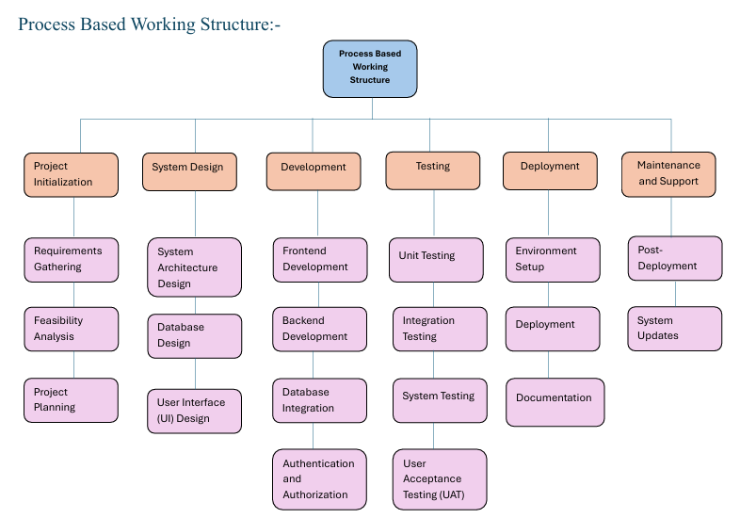
Work Breakdown Structure
Process-Based Work Breakdown Structure

Slide 5
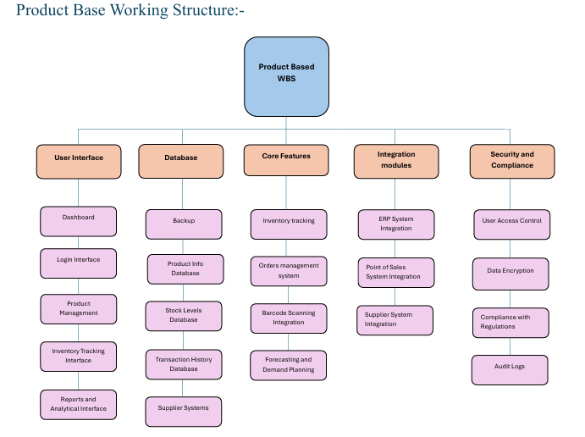
• Product-Based Work Breakdown Structure

Slide 6
SRS Document
Functional Requirements :
User Authentication - User authentication is a critical component of the system that ensures that only authorized personnel can access and modify inventory data. The system will support multi-factor authentication (MFA) to add an extra layer of security. Users will be categorized based on roles, such as administrators, inventory managers, and sales staff, ensuring that each has appropriate access levels. The system will log all login attempts and notify administrators of failed attempts to prevent unauthorized access.
Inventory Tracking - The inventory tracking module will allow real-time monitoring of stock levels across multiple locations. Each item will have a unique identifier, and barcode scanning will be integrated for accurate and efficient stock management. Automated alerts will notify managers when stock reaches a predefined threshold, enabling timely restocking. The system will also track expiration dates for perishable goods, reducing waste and preventing stock shortages.
Order Management - Order management will handle purchase orders from suppliers and sales orders from customers. The system will allow businesses to automate order processing, track shipments, and generate invoices. It will support bulk ordering, order cancellation, and modification. Integration with third-party supplier APIs will enable automatic order placement when stock levels fall below the set limit. The system will maintain order histories for auditing purposes.
Reporting and Analytics - Reporting and analytics will provide insights into stock movement, sales trends, and supplier performance. The system will generate real-time reports on stock levels, order status, and revenue trends. Advanced analytics will use predictive modeling to help businesses optimize stock levels and avoid overstocking. Export options for reports will include PDF, Excel, and CSV formats, ensuring compatibility with external accounting systems.

Slide 7
• Non-Functional Requirements :
1) Performance Requirements - The system should be capable of handling at least 10,000 concurrent users without significant latency. Inventory search queries should return results within 2 seconds under normal operating conditions. The system will use caching mechanisms to enhance response time and optimize database performance. Load balancing techniques will be implemented to distribute traffic efficiently, ensuring high-speed operations even during peak hours.
2) Safety Requirements - Safety features will ensure that the system is resistant to power failures and other unexpected events. Automated backup mechanisms will be in place to prevent data loss, with backups scheduled daily and stored securely in encrypted cloud storage. In case of hardware failures, the system will support automatic failover to backup servers, ensuring continuous availability. Additionally, an emergency shutdown mechanism will be implemented to prevent data corruption in the event of a system crash.
3) Security Requirements - Security will be a top priority, ensuring that inventory data remains confidential and protected from unauthorized access. Data encryption will be implemented for all sensitive data. Role-based access control (RBAC) will be enforced to limit user privileges. The system will comply with industry security standards, ensuring secure handling of financial transactions. Logs of all user activities will be maintained for audit purposes.
4) Software Quality Attributes -The system will prioritize usability, ensuring that even non-technical users can navigate the interface with ease. A responsive design will ensure compatibility across desktops, tablets, and mobile devices. Scalability will be a key consideration, allowing the system to expand as the business grows. High reliability will be achieved through rigorous testing and failover mechanisms, ensuring minimal downtime. Maintainability will be supported through modular coding practices, allowing for easy updates and feature enhancements.

Slide 8
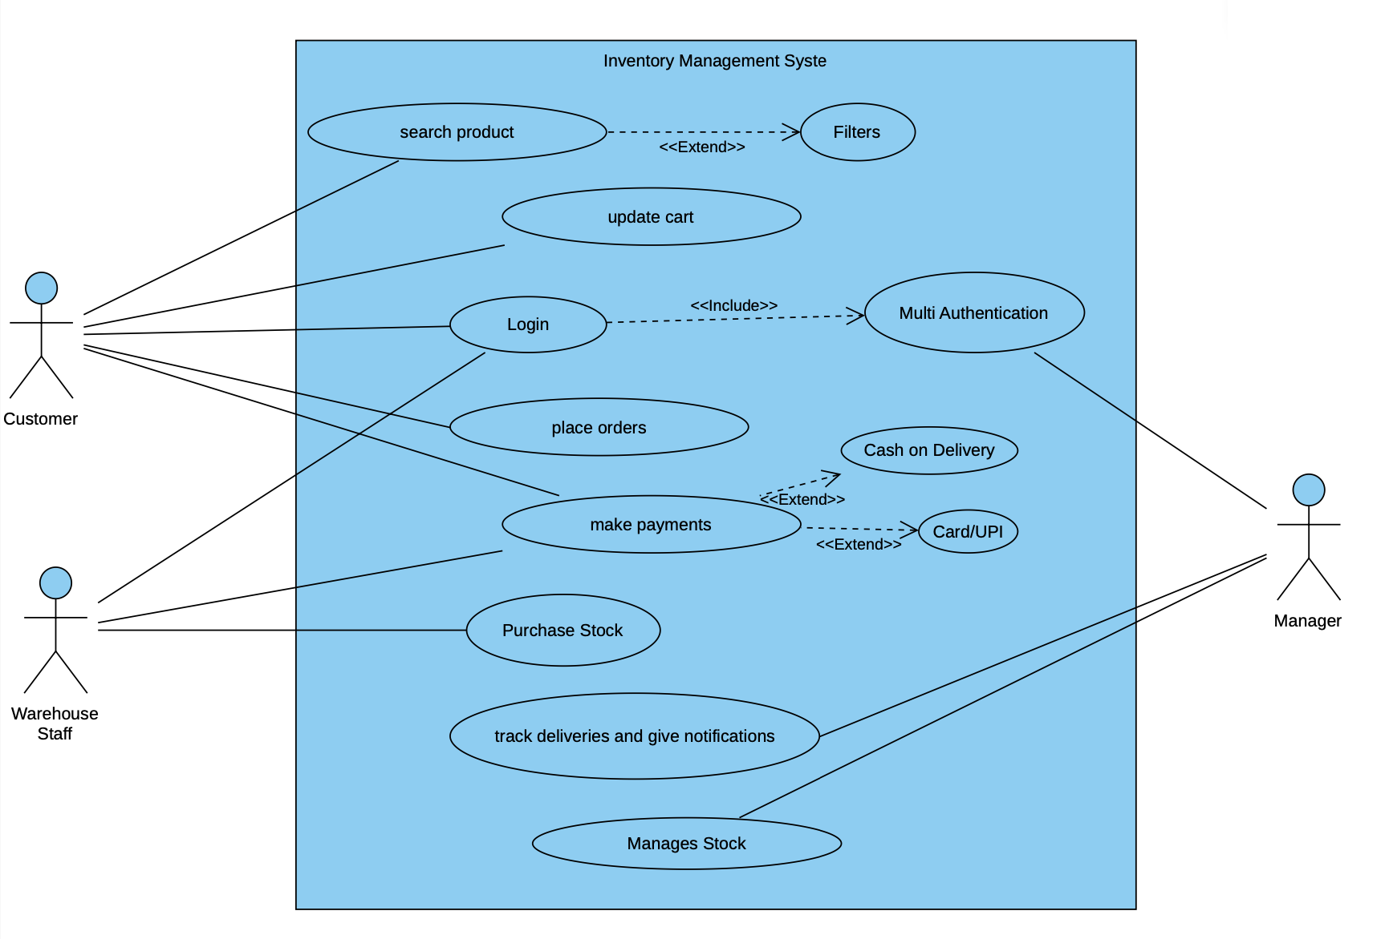
UML - Diagrams
use-case diagram

Slide 9
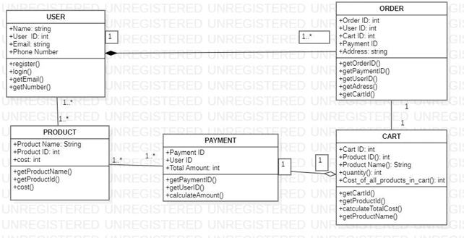
• class diagram

Slide 10
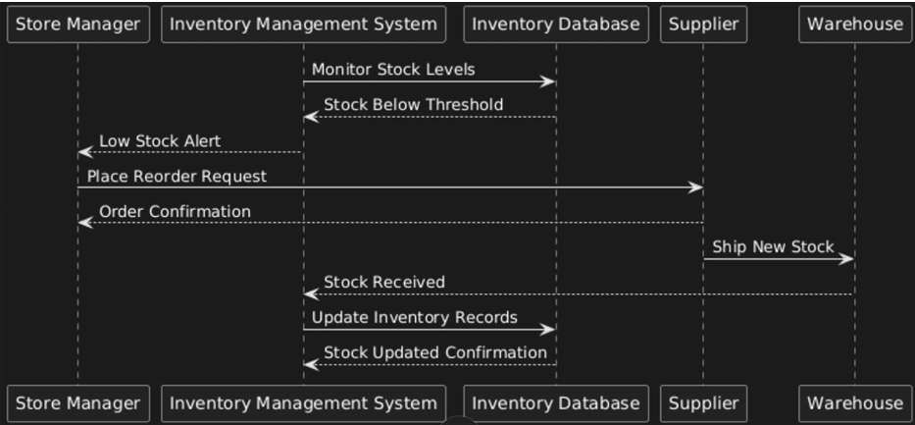
• sequence diagram
Scenario 1: Low Stock Alert & Reorder Process:

Slide 11
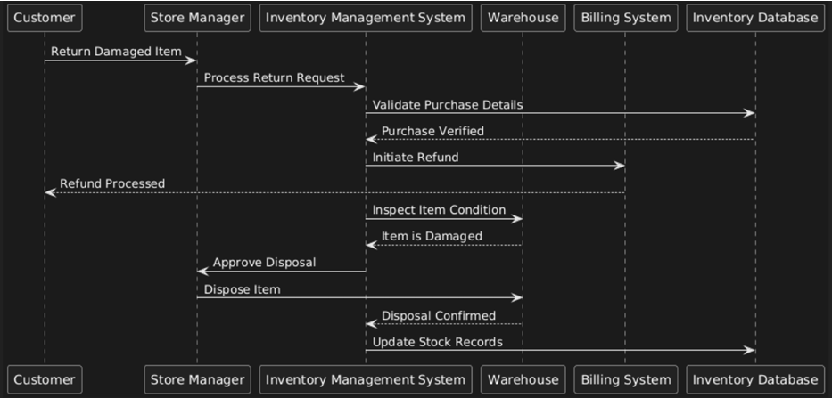
• sequence diagram
Scenario 2: Damaged Item Return & Restocking:

Slide 12
Testing
Test Case 1 :
Test Case ID: TC001
Test Scenario: Verify real-time inventory tracking and low stock alert functionality.
Test Case Description: Ensure that the inventory tracking module accurately updates stock levels and triggers an alert when the quantity of an item falls below a predefined threshold.
Test Steps:
1.Login as an Inventory Manager.
2.Navigate to the Inventory Dashboard.
3.Select an inventory item with a set low stock threshold (e.g., 10 units).
4.Update the stock level for that item to a quantity below the threshold (e.g., 8 units).
5.Verify that the system triggers a low stock alert notification on the dashboard.
6.Confirm that an email/SMS notification (if configured) is sent to the inventory manager.
Test Data:
1) Inventory Item: “Item A” with a threshold set at 10 units.
2) Update Value: New stock level set to 8 units.

Slide 13
Test Expected Result:
1)The system should automatically update the item’s stock level in real time.
2)A low stock alert should be triggered and visibly displayed on the dashboard.
3)An additional notification (email/SMS) should be sent to alert the inventory manager.
Actual Result:
Stock level updated to 8 units, triggering a low stock alert and sending a notification.
Pass/Fail: Pass
• Test Case 2 :
Test Case ID: TC002
Test Scenario: Verify Order Management Functionality for Order Placement and Cancellation.
Test Case Description: Ensure that the order management module allows authorized users to create a new order with valid data, receive a confirmation with a unique order ID, and subsequently cancel the order, with the system updating the order status accordingly.
Test Steps:
Log in as a Sales Staff member.
Navigate to the Order Management module.
Create a new order by entering customer details and selecting items (e.g., Item A and Item B with specified quantities).
Click the "Submit Order" button.

Slide 14
5. Verify that a confirmation message with a unique order ID is displayed.
6. Locate the newly created order in the order list.
7. Select the order and click the "Cancel Order" option.
8. Confirm the cancellation action when prompted.
9. Verify that the order status updates to "Canceled" and the order is removed from the pending orders list.
Test Data:
Customer Name: John Doe
Order Items:
Item A, Quantity: 5
Item B, Quantity: 2
Test Expected Result:
The system should display a confirmation message with a unique order ID upon order submission.
On order cancellation, the order status should update to "Canceled," and the order should no longer appear in the list of active or pending orders.
Actual Result:
Order is successfully created with a confirmation message and unique order ID, then canceled as expected with the system reflecting the status change
Pass/Fail: Pass

Slide 15
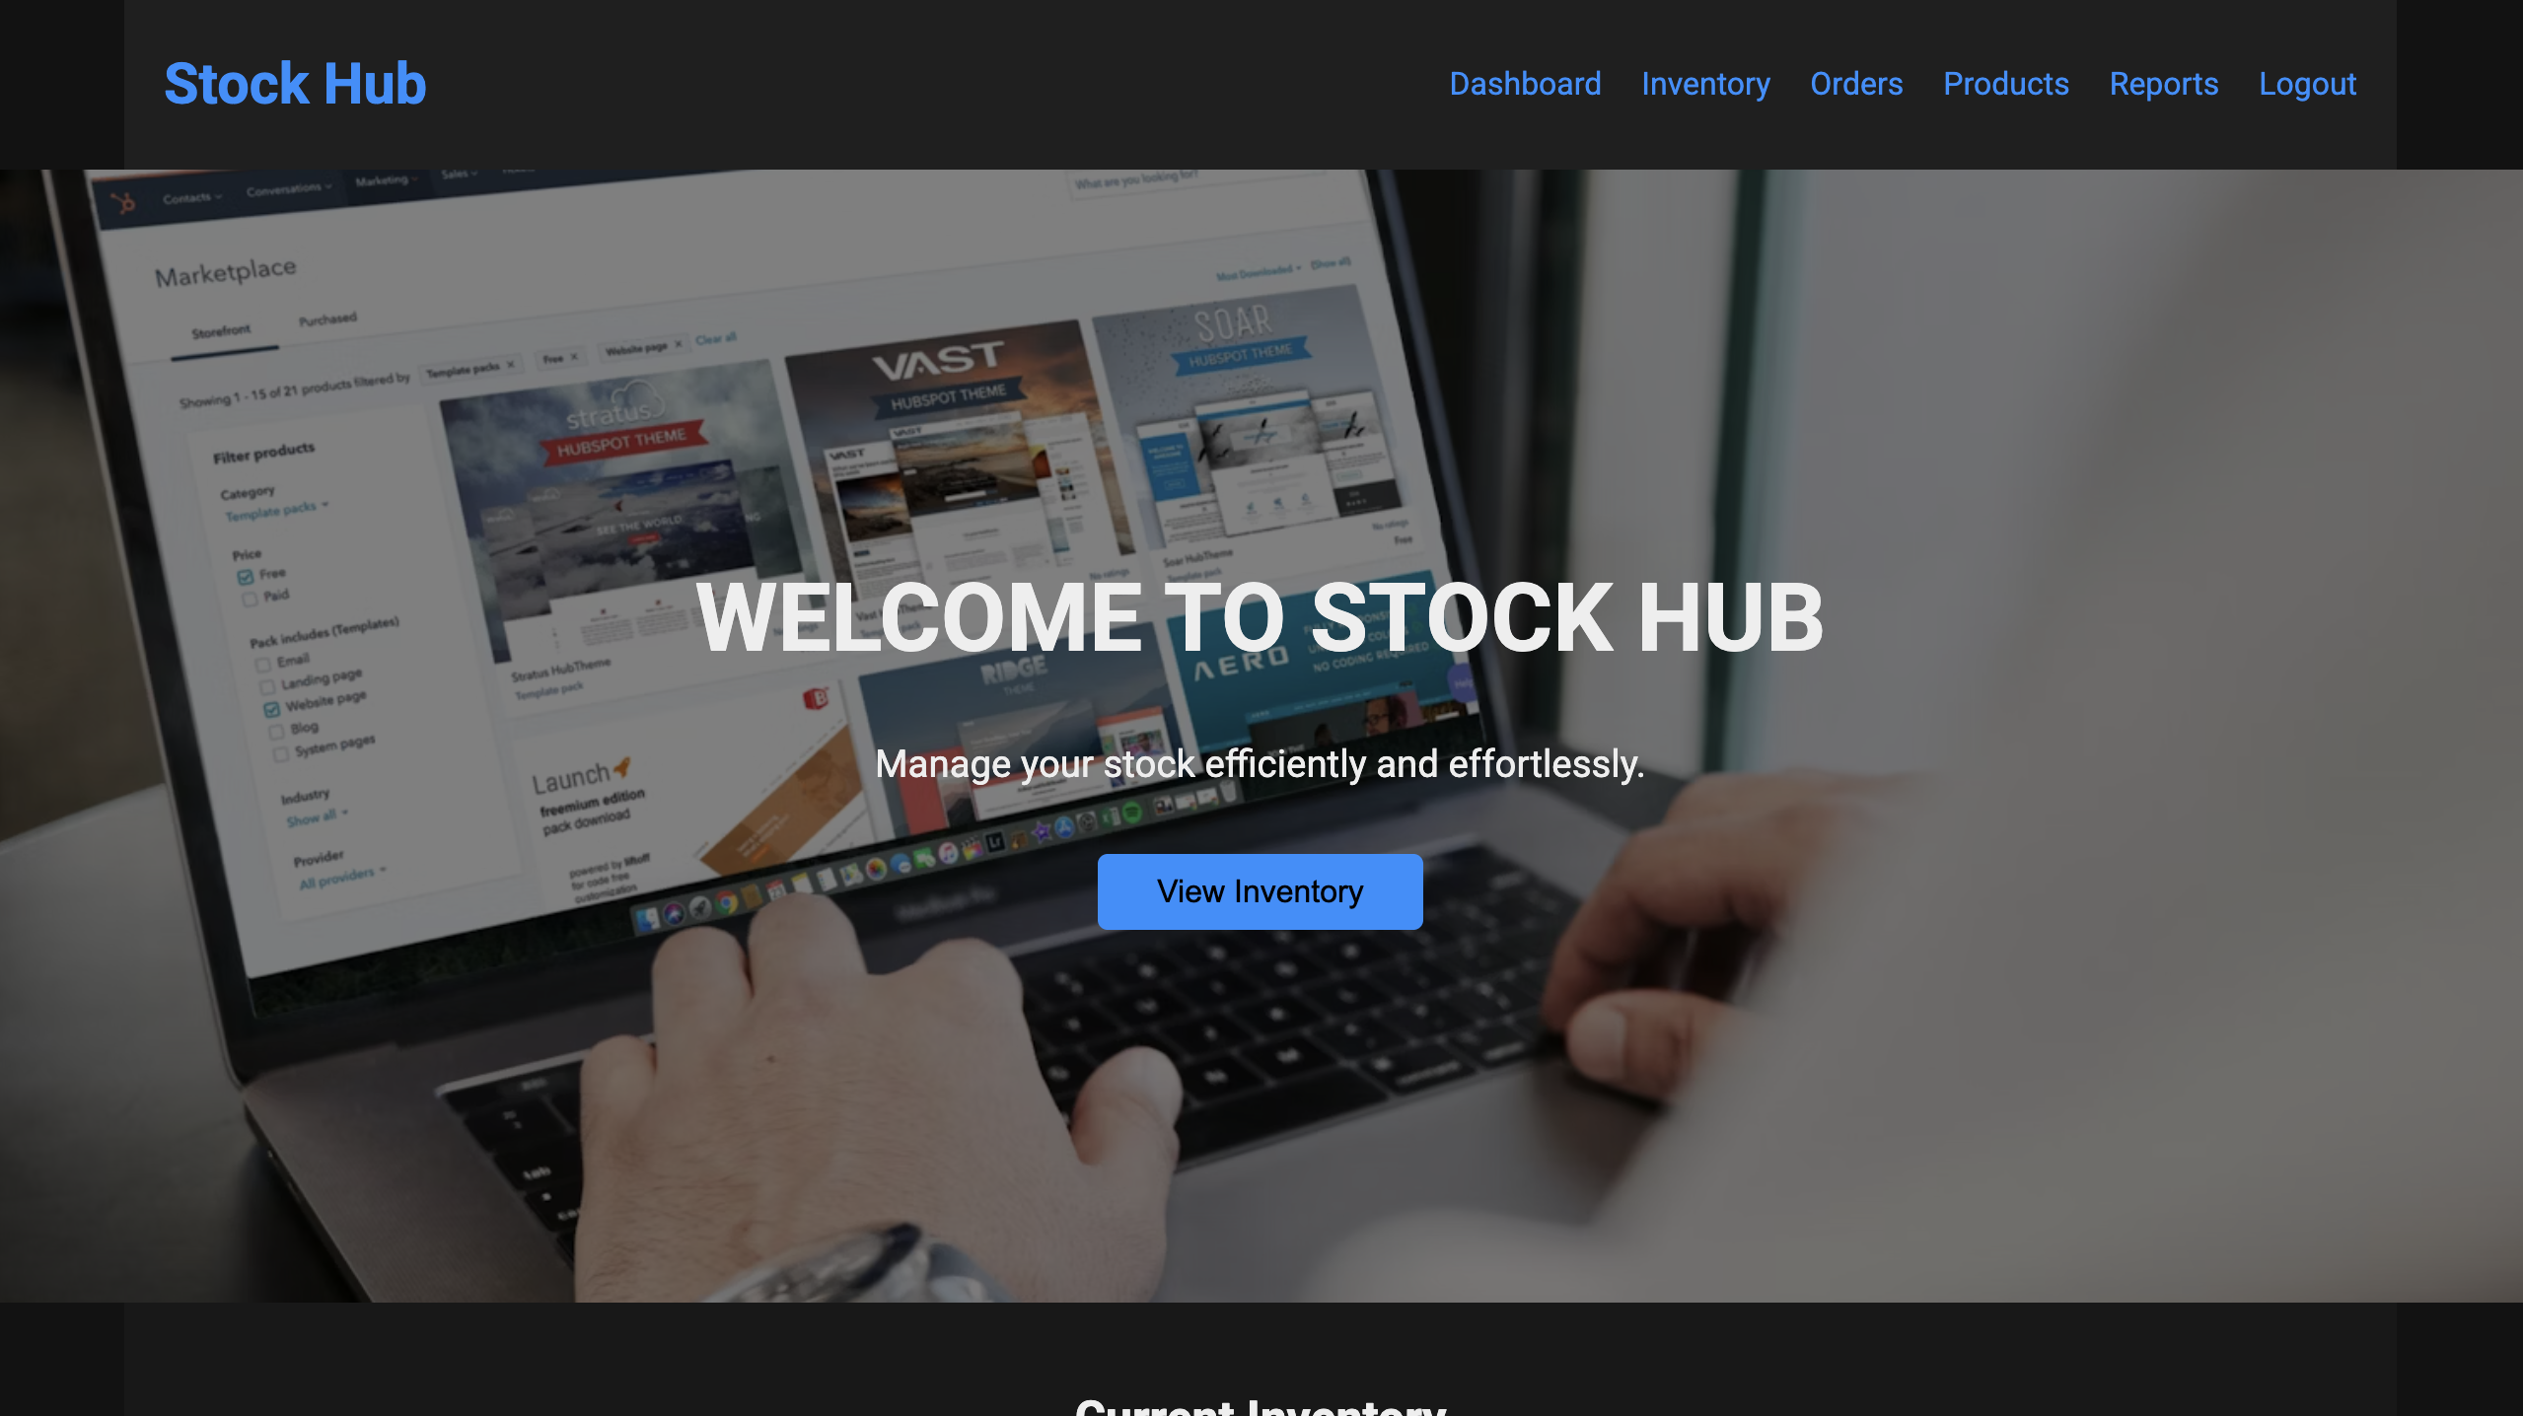
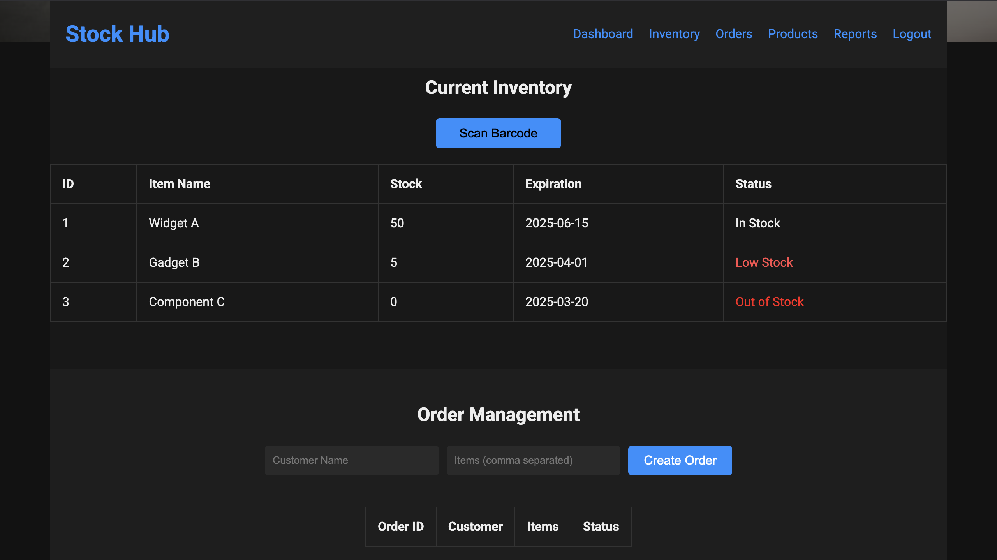
Project – UI Screenshots
Screenshot 1
Screenshot 2

Slide 16
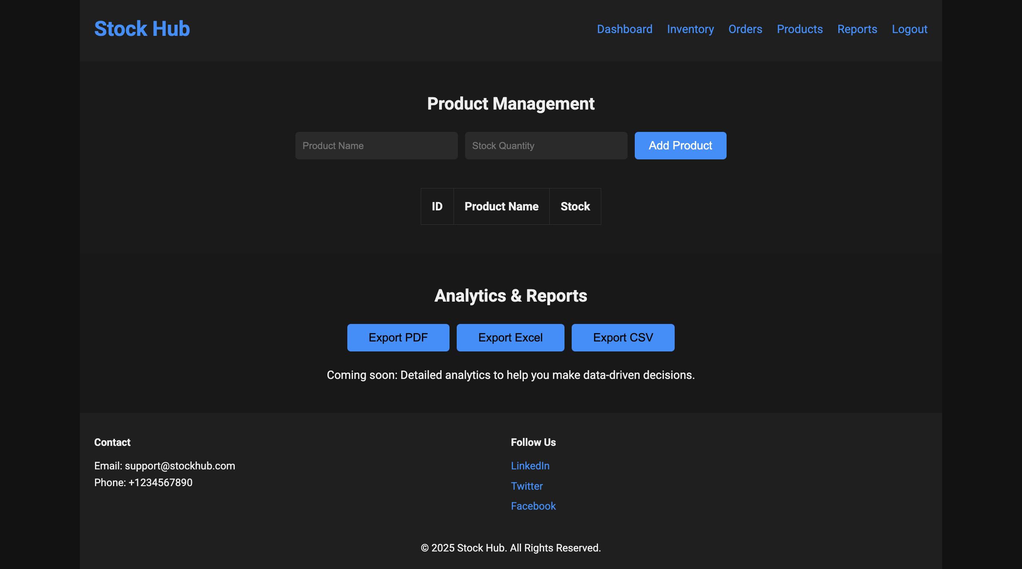
Screenshot 3

Slide 17
GitHub Link for Codes
https://github.com/JayeshPani/Stock-hub

